Slide 1
CM122/222 Algorithms in Bioinformatics
Discussion 1C
Xuheng Li
(Slides Prepared by Xuheng Li)

Slide 2
Outline
Task: Multiple pattern matching problem
Approaches
Brute-force pattern matching
Trie maching
Suffix trie, suffix tree and suffix array
Burrows-Wheeler Transform (BWT)

Slide 3
Task: Multiple pattern matching problem
Find all occurrences of a collection of patterns in a text.
Input:
A string Text;
A collection Patterns containing shorter strings.
Output: All starting positions in Text where a string from Patterns appears as a substring.
Example:
Input:
Text = AATCGGGTTCAATCGGGGT
Patterns = {ATCG, GGGT}
Output:
ATCG: 1, 11; GGGT: 4, 15.
Notes:
Multiple matching requires that
The algorithm processes Text once (cannot scan Text for each pattern);
Processing of each pattern is relatively independent (in case there are too many reads).

Slide 4
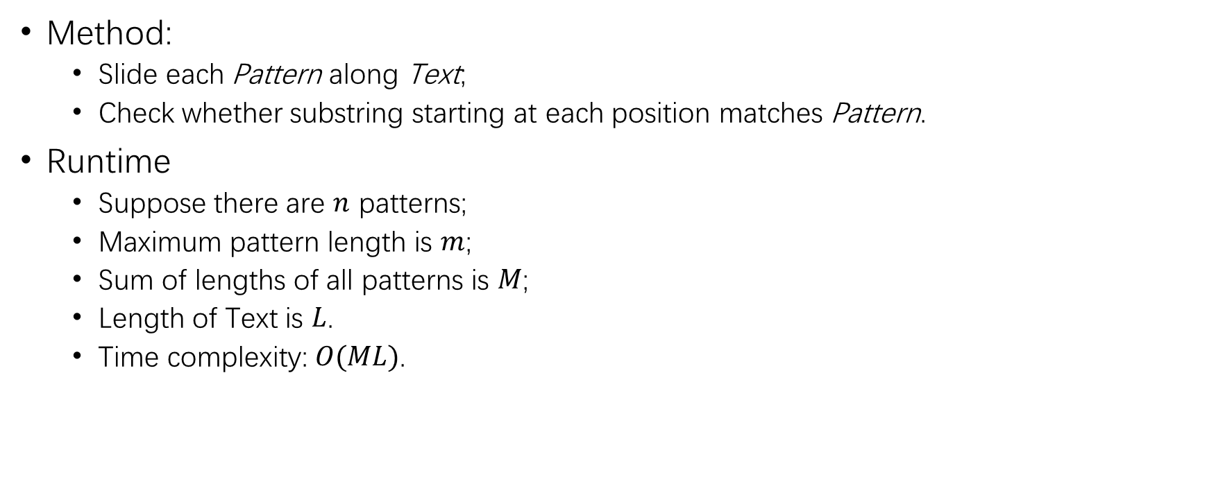
Brute-force pattern matching
Method:
Slide each Pattern along Text;
Check whether substring starting at each position matches Pattern.
Runtime
Suppose there are $n$ patterns;
Maximum pattern length is $m$;
Sum of lengths of all patterns is $M$;
Length of Text is $L$.
Time complexity: $O(ML)$.

Slide 5
Trie Matching

Slide 6
Trie
Components of a trie:
A trie is a tree;
Nodes, including a root node and leaf nodes.
Edges, each labelled by a letter of the alphabet.
Properties:
Different edges coming out of a node have different labels;
Each path from the root node to a leaf node represents a pattern.

Slide 7
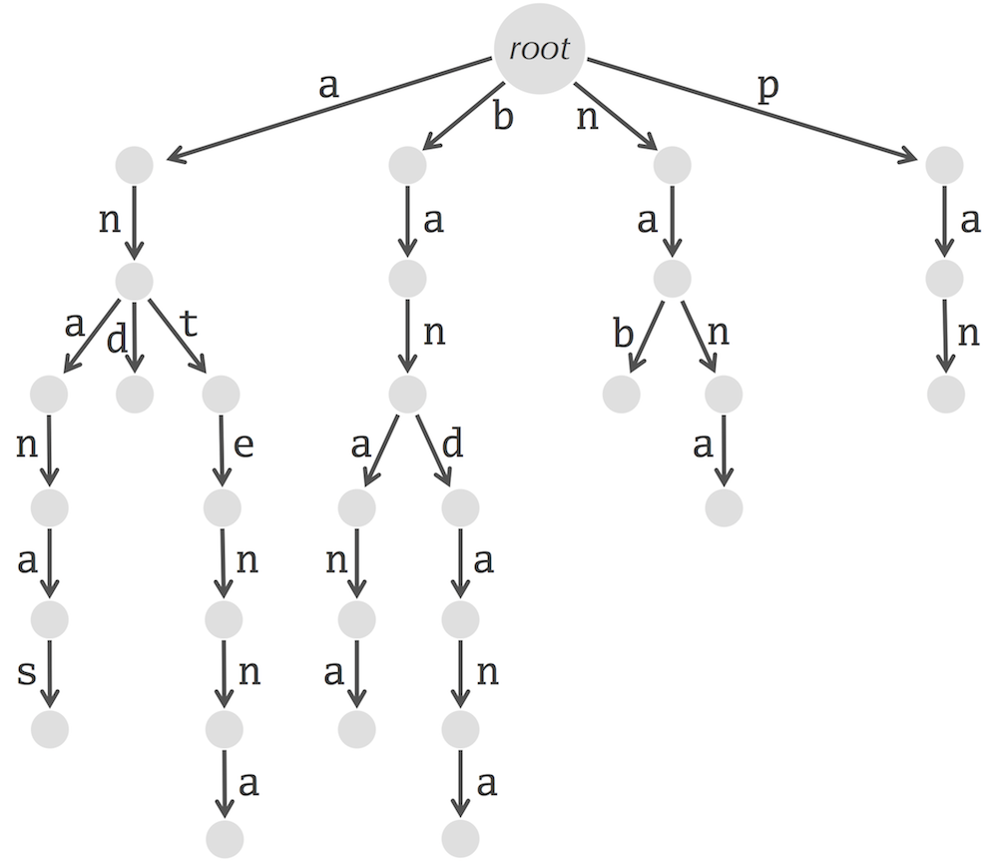
Trie
Patterns encoded in the trie:
ananas
and
antenna
banana
bandana
nab
nana
pan
Textbook Chapter 9.3

Slide 8
Trie construction
9.3 Q4
To add Pattern to the trie:
Start with the root node.
For each letter in Pattern:
If the current node has an outgoing edge labelled by letter, then proceed along this edge to another node;
Else, create a new node and an edge from the current node to the new node labelled by letter. Proceed to the new node.

Slide 9
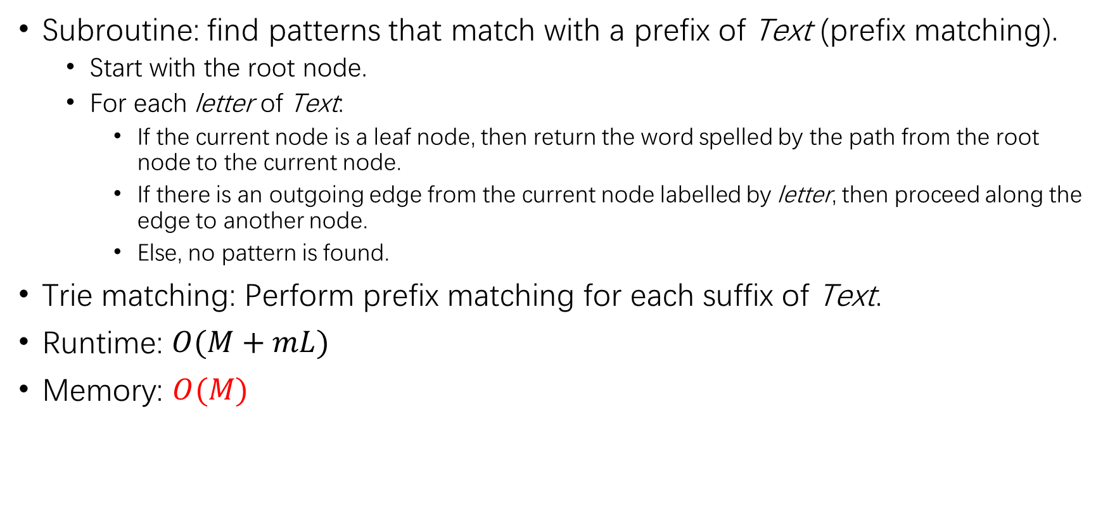
Trie matching
Subroutine: find patterns that match with a prefix of Text (prefix matching).
Start with the root node.
For each letter of Text:
If the current node is a leaf node, then return the word spelled by the path from the root node to the current node.
If there is an outgoing edge from the current node labelled by letter, then proceed along the edge to another node.
Else, no pattern is found.
Trie matching: Perform prefix matching for each suffix of Text.
Runtime: $O(M+mL)$
Memory: $O(M)$

Slide 10
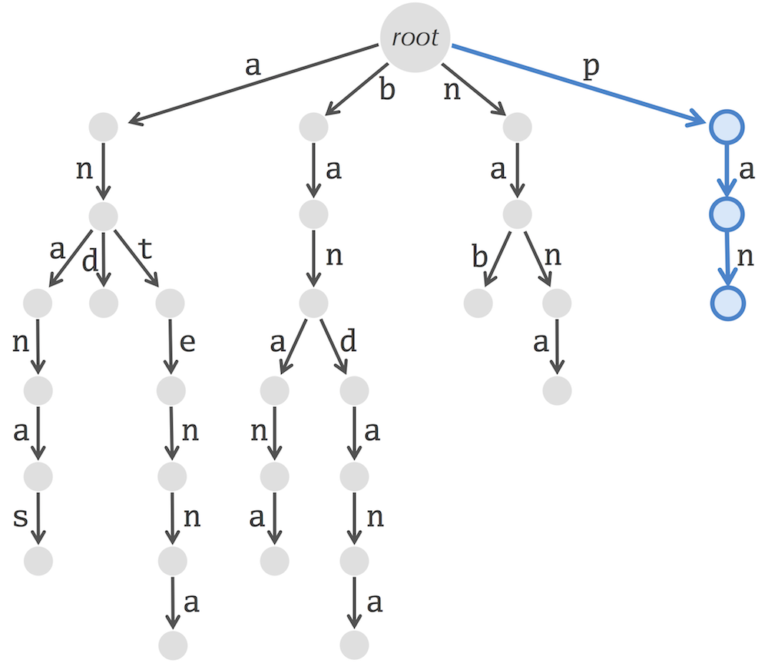
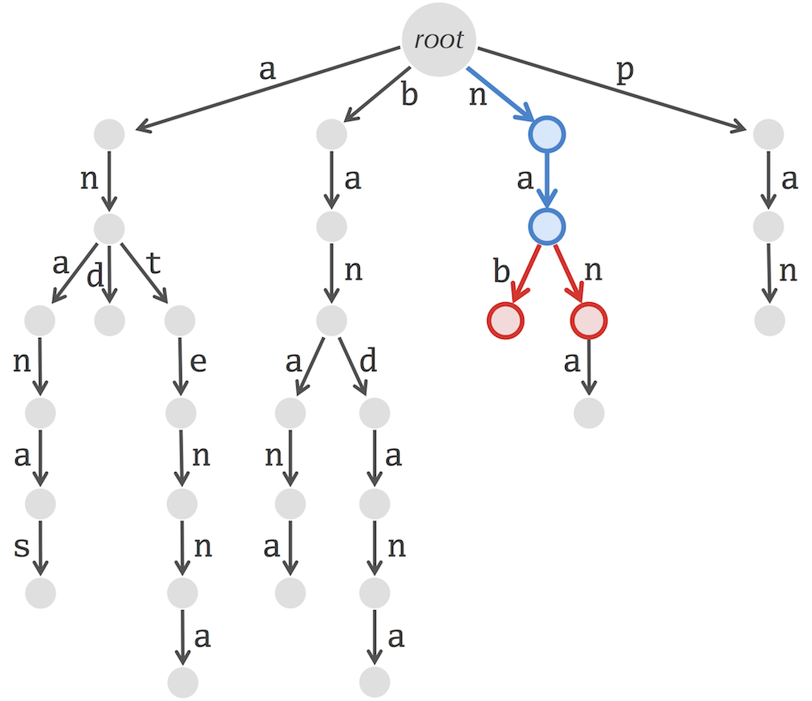
Trie matching
Textbook Chapter 9.3
Text = panamabananas. Successful match from 1st letter of Text. No pattern matches from 3rd letter of Text.

Slide 11
Problem with Trie Matching
What if one pattern is the prefix of another?
Example: Patterns = {A, AA}
What is the corresponding trie?
Cannot determine the end of a pattern by whether a leaf node is reached!
Solution:
Append “$” to each pattern.
End of a pattern: node with an outgoing edge labelled ”$”.

Slide 12
Suffix Trie, Suffix Tree, Suffix Array

Slide 13
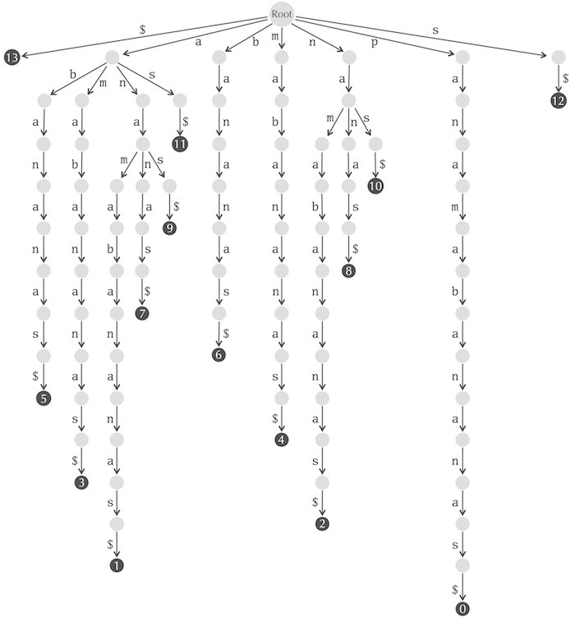
Suffix trie
A suffix trie is a trie that encodes all suffixes of Text (with “$” appended).
Each leaf marks the starting position of the suffix.
Textbook Chapter 9.4

Slide 14
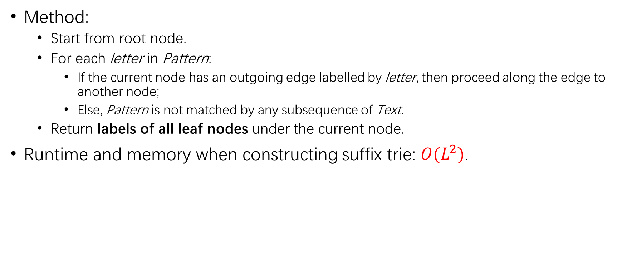
Suffix trie matching
Method:
Start from root node.
For each letter in Pattern:
If the current node has an outgoing edge labelled by letter, then proceed along the edge to another node;
Else, Pattern is not matched by any subsequence of Text.
Return labels of all leaf nodes under the current node.
Runtime and memory when constructing suffix trie: $O(L^{2})$.

Slide 15
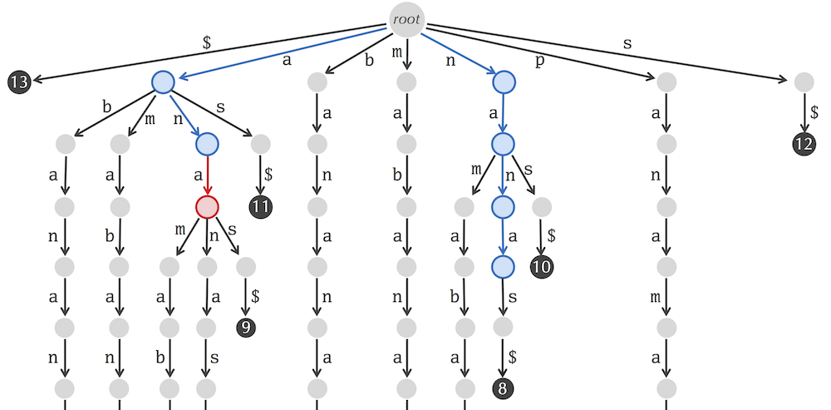
Suffix trie matching
Textbook Chapter 9.4

Slide 16
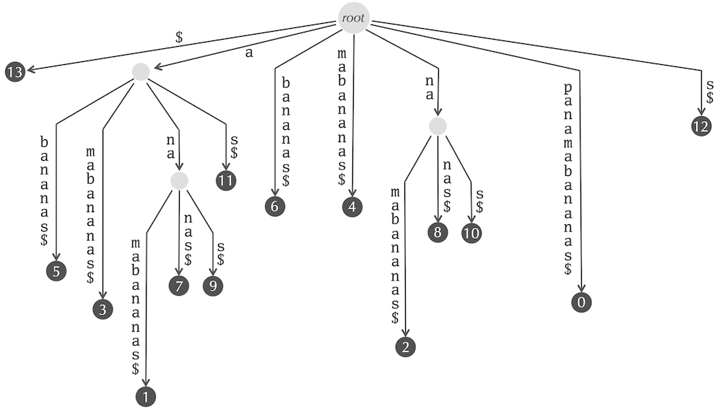
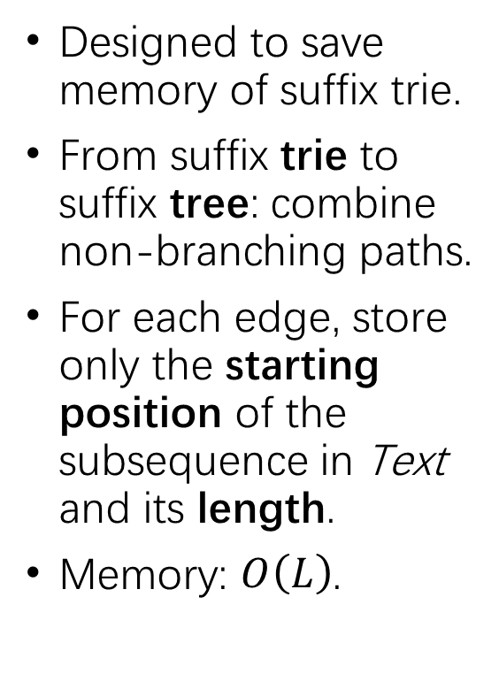
Suffix tree
Designed to save memory of suffix trie.
From suffix trie to suffix tree: combine non-branching paths.
For each edge, store only the starting position of the subsequence in Text and its length.
Memory: $O\left(L\right)$.
Textbook Chapter 9.5
Notes:
Adding each suffix creates a maximum of 2 new nodes.

Slide 17
Suffix tree construction
9.5 Q4
To add a suffix:
Proceed down the suffix tree until no edge matches the prefix of the remaining pattern.
Case 1: No edge shares any prefix of the remaining pattern.
Example: add TC$ to Root --C$-> Leaf
Create new node and connect.
Case 2: Some edge shares part of the prefix of the remaining pattern.
Example: add TT$ to Root --T$-> Leaf
Break up edge, create new node and connect with intermediate node.

Slide 18
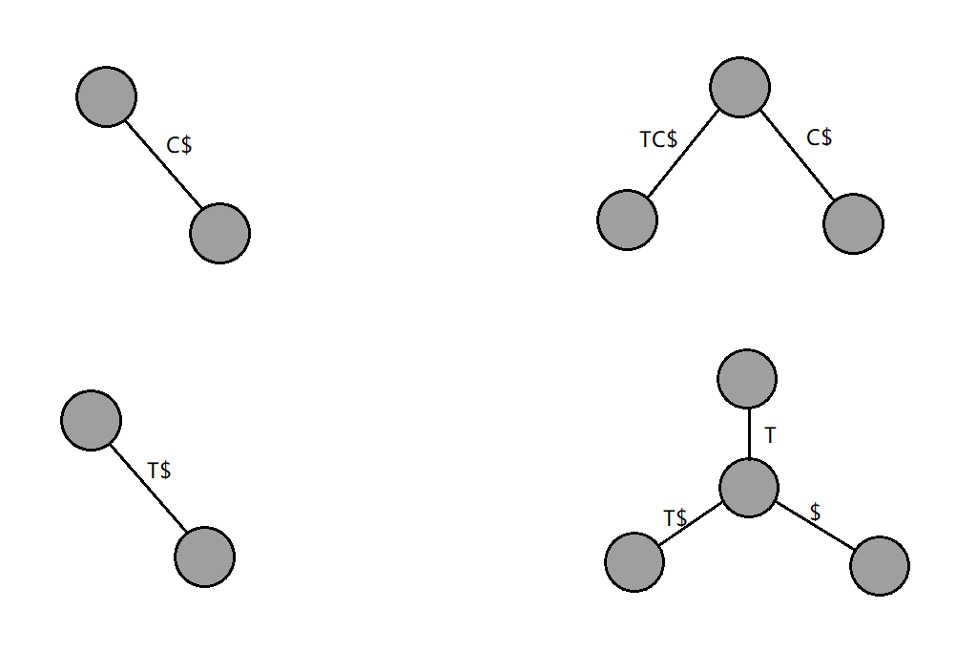
Suffix tree construction

Slide 19
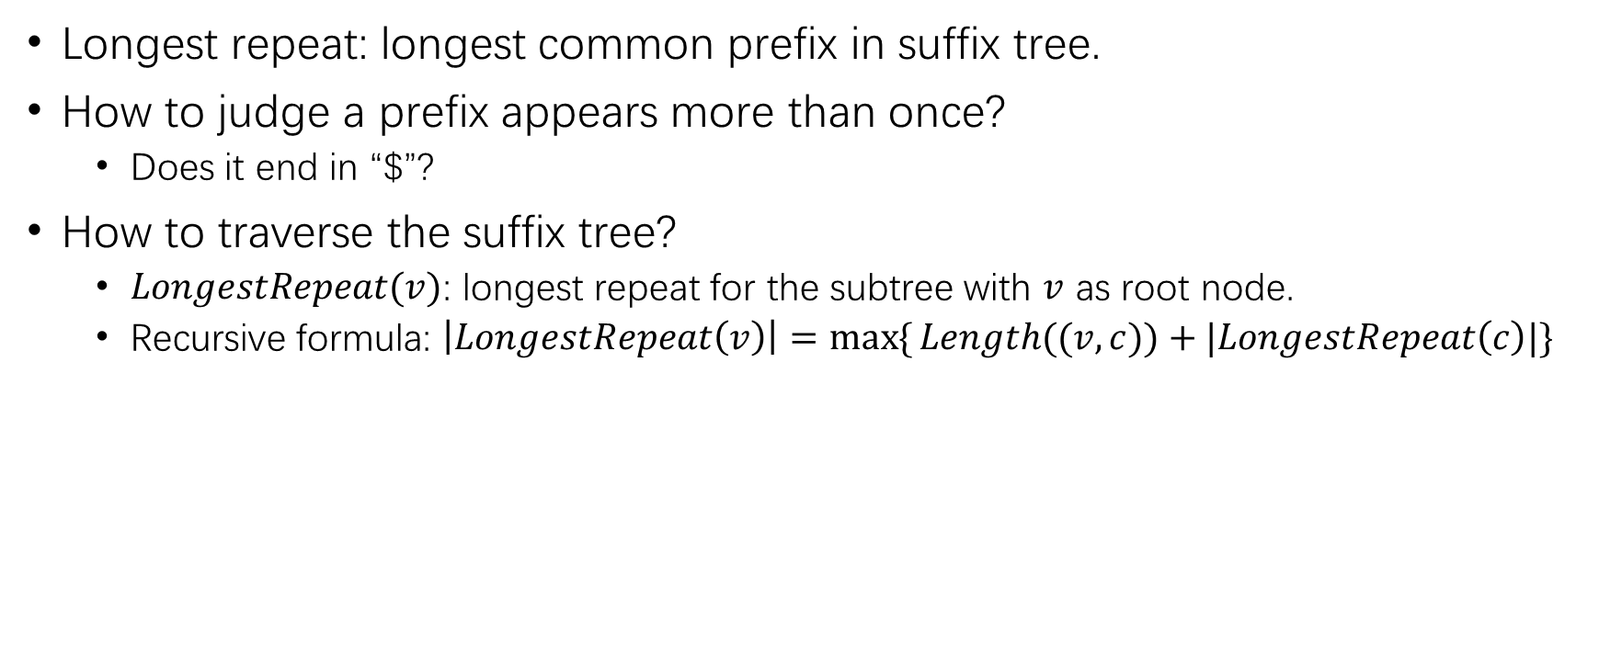
Detour: Longest repeat problem
9.5 Q5
Longest repeat: longest common prefix in suffix tree.
How to judge a prefix appears more than once?
Does it end in “$”?
How to traverse the suffix tree?
$LongestRepeat(v)$: longest repeat for the subtree with $v$ as root node.
Recursive formula: $\left|LongestRepeat\left(v\right)\right|=\max{\{}Length((v, c))+|LongestRepeat\left(c\right)|\}$

Slide 20
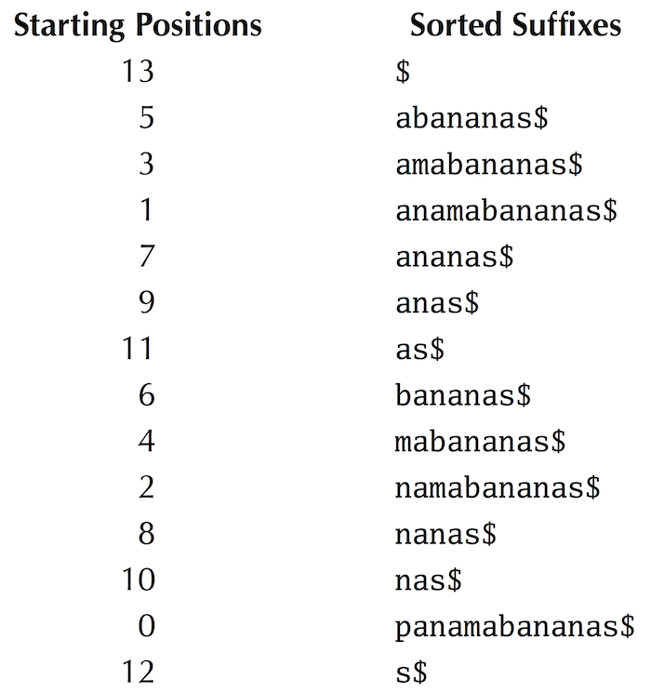
Suffix array
9.6 Q2
Construction:
Sort suffixes of Text lexicographically (“$” comes first);
List starting positions.
Suffix array matching:
Use binary search among all suffixes to find first occurrence of Pattern in suffix array;
Use binary search after the first occurrence of Pattern to find its last occurrence of in suffix array.
Textbook Chapter 9.6

Slide 21
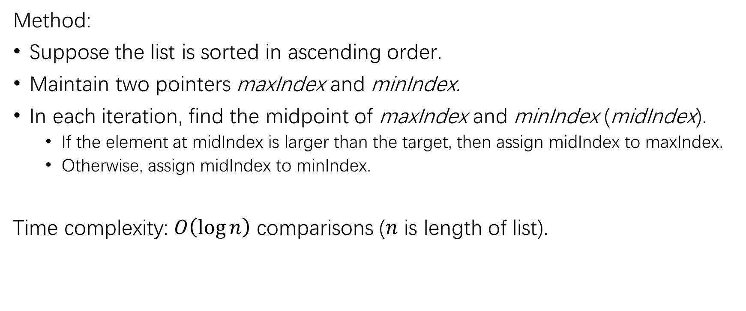
Detour: Binary search
Method:
Suppose the list is sorted in ascending order.
Maintain two pointers maxIndex and minIndex.
In each iteration, find the midpoint of maxIndex and minIndex (midIndex).
If the element at midIndex is larger than the target, then assign midIndex to maxIndex.
Otherwise, assign midIndex to minIndex.
Time complexity: $O\left(\log{n}\right)$ comparisons ($n$ is length of list).

Slide 22
Burrows-Wheeler Transform (BWT)

Slide 23
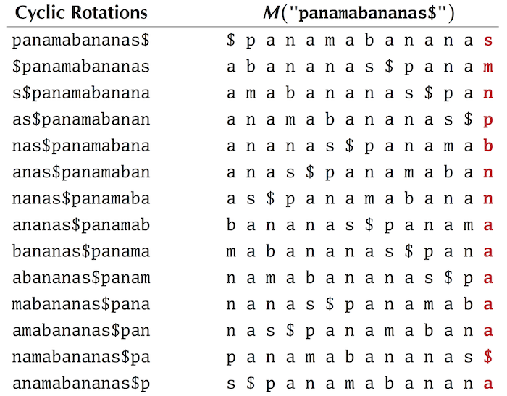
BWT construction
9.7 Q5
List all cyclic rotations;
Sort cyclic rotations to get Burrows-Wheeler matrix (BWM).
BWT = last column of BWM.
Textbook Chapter 9.7

Slide 24
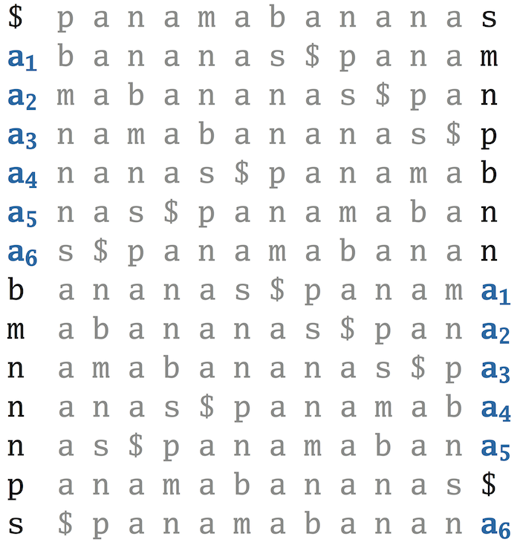
First-last property
The k-th occurrence of a symbol in the first column and the k-th occurrence in the last column correspond to the same position in Text.
Why?
Consider all occurrences of a symbol in the first column.
After moving the symbol to the end of each of these rows, they will still be sorted.
Moreover, they become the rows with the symbol in the last column.
Textbook Chapter 9.9

Slide 25
Inverse BWT
9.9 Q11
How to locate the first symbol of Text?
Consider the row ending in “$”.
How to determine the next symbol?
Use first-last property.

Slide 26
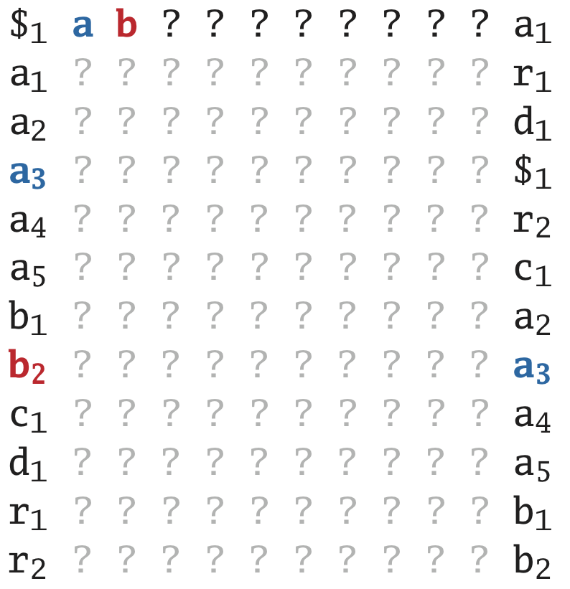
Inverse BWT
Textbook Chapter 9.9
Notes:
Do it on board

Slide 27
Inverse BWT (another approach)
Previous approach:
Start with the first symbol of Text.
Proceed forward.
We can also start with the last symbol of Text (“$”) and proceed backward.
Proceed backward: use first-last property

Slide 28
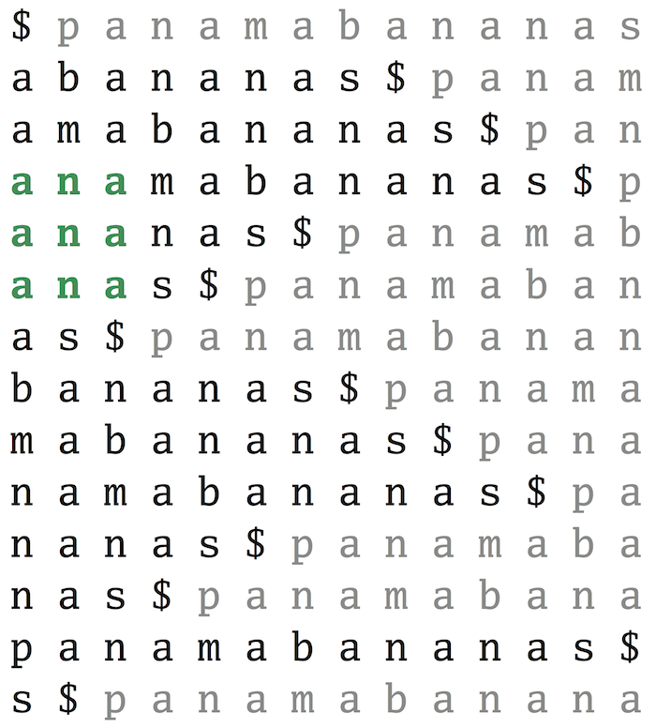
BW matching
First attempt: BW matrix.
Problem: Construction of BWM is expensive!
Solution: Use first-last property to avoid construction of entire matrix.
Textbook Chapter 9.10

Slide 29
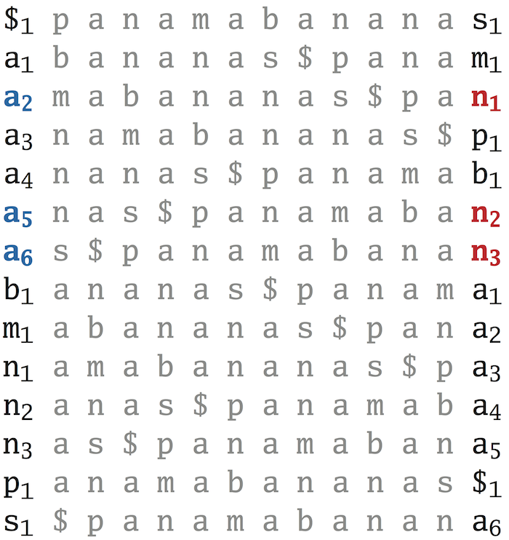
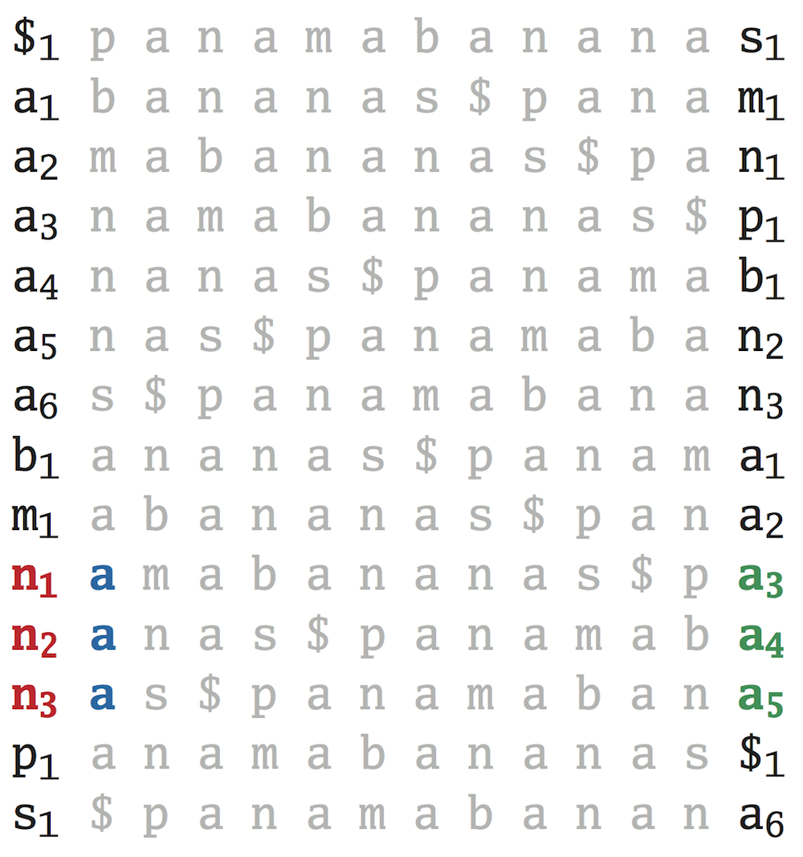
BW matching: 1st speedup
Textbook Chapter 9.10
Start with the last symbol.
Locate all occurrences of previous symbol of Pattern in the last column.
Locate the corresponding locations in the first column (LastToFirst mapping).

Slide 30
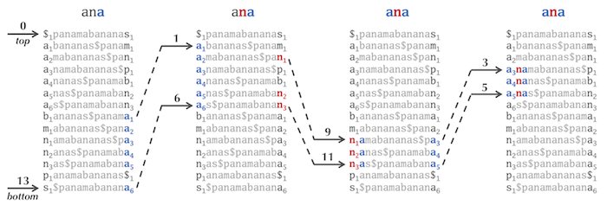
BW matching: 2nd speedup
9.10 Q8
Textbook Chapter 9.10
Observation: Consecutive occurrences of any symbol in the last column correspond to consecutive occurrences in the first column.
Finding all occurrences reduced to finding first and last occurrences.
Maintain two pointers top and bottom.

Slide 31
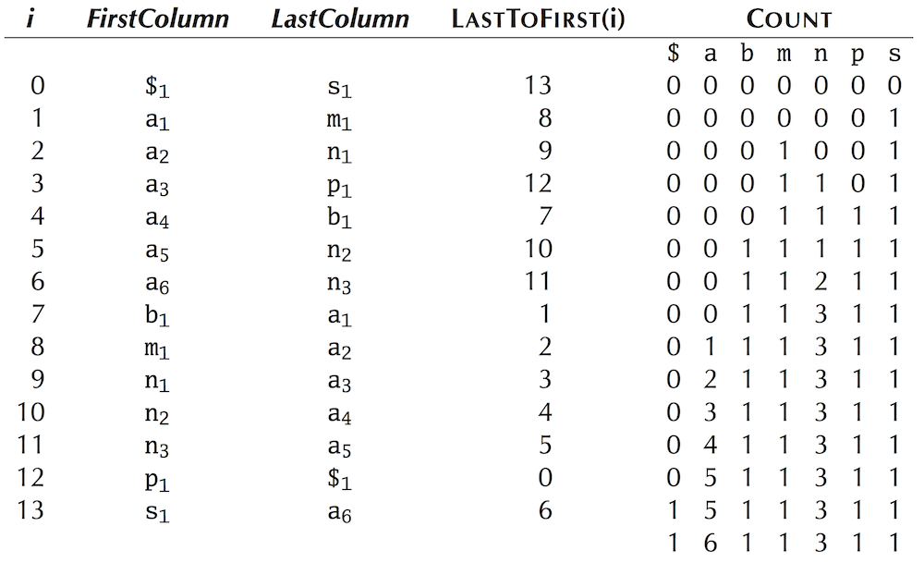
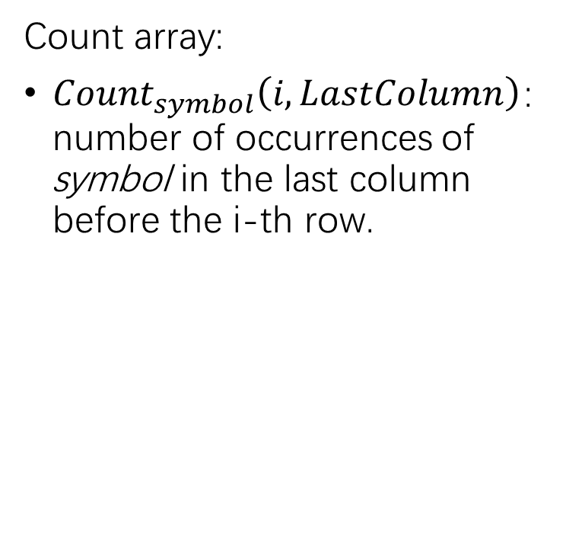
BW matching: 3rd speedup
Count array:
${Count}_{symbol}\left(i, LastColumn\right)$: number of occurrences of symbol in the last column before the i-th row.
Textbook Chapter 9.11

Slide 32
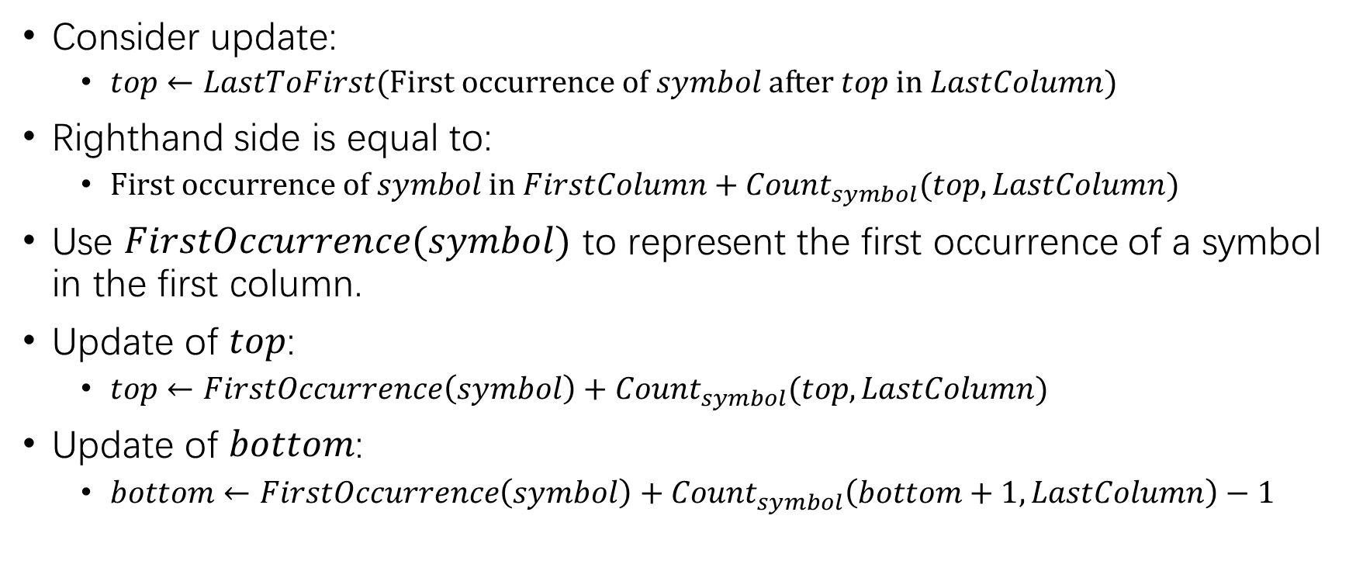
BW matching: 3rd speedup
9.11 Q7
Consider update:
$top←LastToFirst(\text{First} \text{occurrence} \text{of} symbol \text{after} top \text{in} LastColumn)$
Righthand side is equal to:
$\text{First} \text{occurrence} \text{of} symbol \text{in} FirstColumn+{Count}_{symbol}(top, LastColumn)$
Use $FirstOccurrence(symbol)$ to represent the first occurrence of a symbol in the first column.
Update of $top$:
$top←FirstOccurrence\left(symbol\right)+{Count}_{symbol}(top, LastColumn)$
Update of $bottom$:
$bottom←FirstOccurrence\left(symbol\right)+{Count}_{symbol}\left(bottom+1, LastColumn\right)−1$

Slide 33
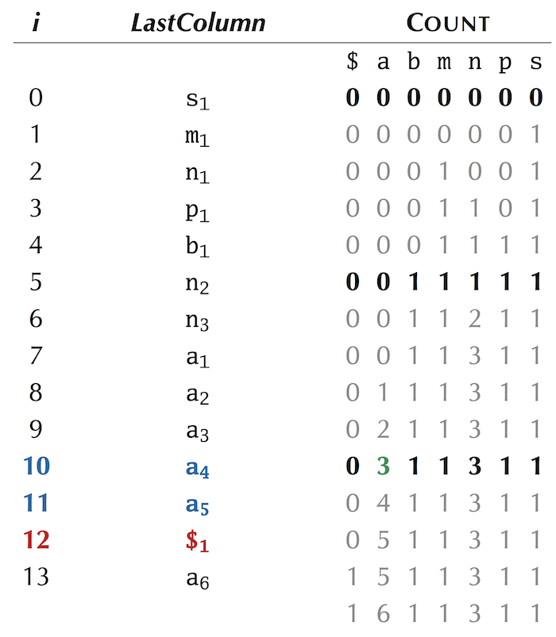
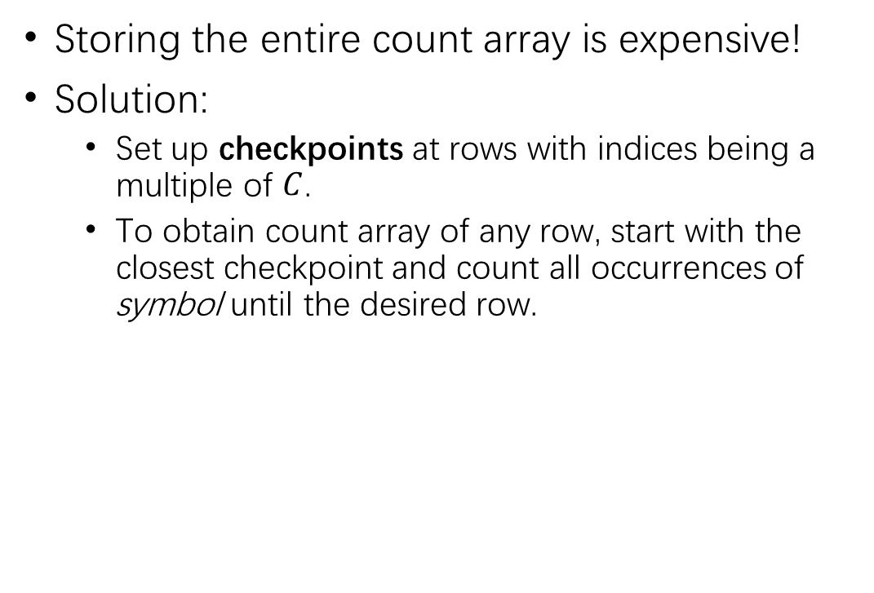
BW matching: further improvement
Storing the entire count array is expensive!
Solution:
Set up checkpoints at rows with indices being a multiple of $C$.
To obtain count array of any row, start with the closest checkpoint and count all occurrences of symbol until the desired row.
Textbook Chapter 9.11

Slide 34
Where are the matched patterns?
Use suffix array.
Also use checkpoints to save memory.

